Slide 1
welcome
Milestone1: Building Trust in the Owner/Design-Builder Relationship
Notes:
Thanks for being here.
It is a fun topic, but may seem a bit unconventional to hear this stuff from an owner. But it is necessary.
In each slide, I will try to tie it back to the idea of building trust.
And I am going to try real hard to NOT simply read slides to you. So if I am talking and you miss the content of the slide, I think we can make it available.

Slide 2
Make sure you have the right Acquisition Strategy
Choosing the right tools for the job is both art and science
Select the best combination of
Project Delivery System
Procurement Method
Contracting Approach
Each project is unique so make informed choices
Notes:
First and foremost, the contracting community needs to be able to trust us, as owners, that we are making informed decisions on our delivery models.
Why I like DB? I mean, for me, think about this (below)
If you were building a home, who would like it if you designed your dream home, and then someone told you that you had to bid that house out and let the cheapest price build it.
Single scope items my be best suited for hard bid.
However, It does take trust, and some just won’t get it. I am going to go into that later.

Slide 3
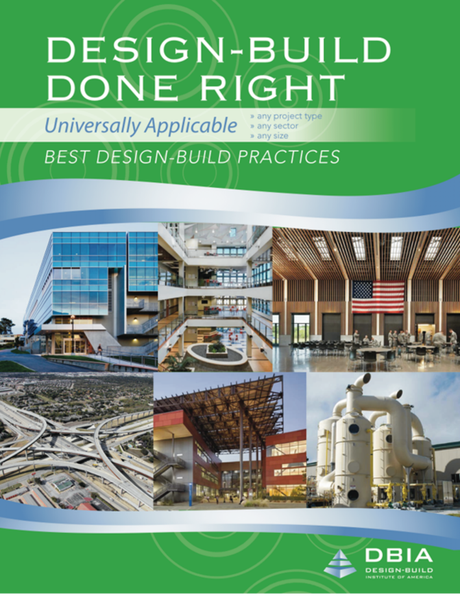
PROCUREMENT
BEST PRACTICE NO. 1
An Owner should conduct a proactive and objective assessment of the unique characteristics of its program/project and its organization before deciding to use design-build.
Notes:
To support the previous, let me refer to DBIA’s procurement best practice #1.
To build trust, you are doing DB because it makes sense, not just because it is popular.
Again, that you as owners are making informed decisions.

Slide 4
Developing Acquisition Strategies
Factors to consider
Owner objectives
Unique project considerations
Owner profile and personality
Marketplace considerations
Notes:
From DBIA cert slides here, it indicates that, among other things
The culture within the Owner’s organization is often as important as any other factor, as some of these bullets indicate.
Especially for a “best value” selection, you and/or your organization may not be ready.
I am going to talk about “trust” and making the “mental shift” away from hard bid practices.
As owners, the builder community needs to be able to trust that we have the right culture.
There is that “trust” word again.

Slide 5
Owner’s Profile and Personality
In-house expertise and resources to procure and manage the project
In-house or reliance on consultants
Decision-making process and ability
Interdepartmental relationships (e.g., facility, procurement and legal)
Culture and reputation (e.g., innovative, risk tolerance, adversarial or fair)
Notes:
When that trust building starts with a builder, they are going to first look at you as an organization.
What is the “Culture” within our organization?
Are we attracting the best & brightest premier Design-Builders?
Relationships are HUGE. As owners, you have to get out and develop those relationships.
It is that critical first step in a “trusting” relationship.
There is no marriage without a first date. Spend some time at industry events and such.
SJSUD getting good looks even when economy was bad and everyone was on the I-80.

Slide 6
History of Project Delivery
Brooks Act
Qualifications Based Procurement of Professional Services
Miller Act
Bonds Required for Federal Construction Projects
Professional Construction Mgmt.
Federal Acquisition Reform Act
Alberti
1st Modern Day Architect
Public Sector Design-Build and Private Sector CMAR
DBIA Established;
2 states with limited DB authority
Brunelleschi
Quintessential Design-Builder
P3 Legislation
Design-Build Authority
in 95% of states
Vitruvius
1st Documentation of Design and Construction
Code of Hammurabi
Rise of Professional Societies
DBIA Best Practices
Private Sector Design-Build
Renaissance
Industrial Revolution
Information Age
1795 BC
40 BC
1412 CE
1456
1850s
1935
1960s
1972
1975
1980s
1993
1996
2000s
2014
2016
2022
Age of the Master Builder
Segregation of Services
Return of Integration
Notes:
Some interesting History for you.
As the timeline reveals … Design-Build is NOT new. For centuries the Master Builder utilized integrated Design-Build singular contract responsibility. It was only the brief time in history (beginning during the Industrial Revolution & receding in the 1980’s) that the process was bifurcated. Hey, guess what, those buildings are still standing! Ever been to downtown Philly?
This bifurcation created some of the distrust and animosity that we experience today.
From Hammurabi – 282 laws w/scaled punishment (Eye for an eye), unless you were rich, to DB today. (Taking the hill together)

Slide 7
Move to Integration
Early contractor involvement
Team member accountability
Improves relationships
Better project metrics and increased certainty of outcomes
Influence of certain fundamental concepts
Cost-influence curve
Benefits of fast tracking
Spearin Doctrine
Notes:
You will see in the subsequent 3 slides that there is a movement on to an integrated model.
For this to be successful, these attributes need to be in place.
The process of integrating also proves to improve relationships, which in turn build trust.
You know, the move to integrate influences the fundamental concepts of “cost-influence”, “scheduling” and risk.

Slide 8
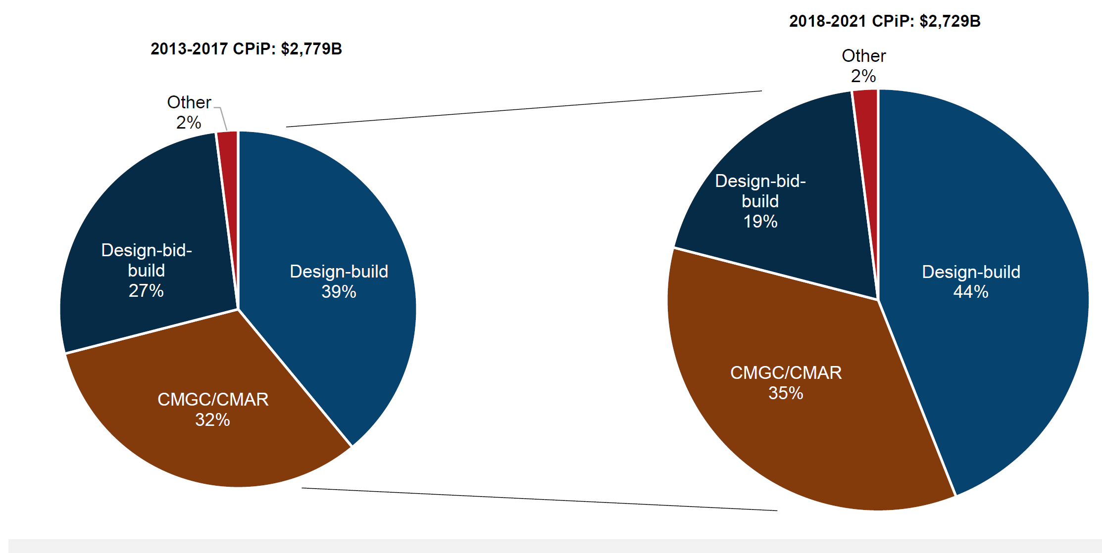
PROJECT DELIVERY METHOD
Market Share for Non-Residential Construction
Board of Directors Orientations – Design Build Institute of America
Notes:
So, I challenged you in the previous slide there is a move to integration, so you owners know that this integrated model is catching on, as stated in previous slide,
So start shifting your mindset to that of trusting, if you haven’t. It will get harder and harder to draw looks to your work if your are not on board with this type of delivery.

Slide 9
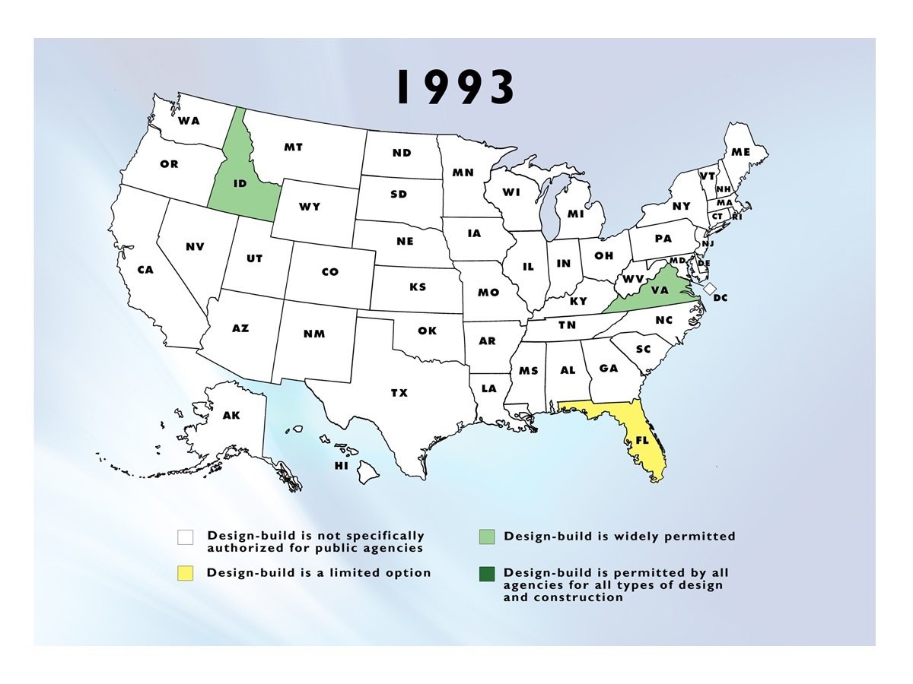
LEGISLATIVE ADVOCACY
State/Local
Board of Directors Orientations – Design Build Institute of America
Notes:
Look at its use in 1993

Slide 10
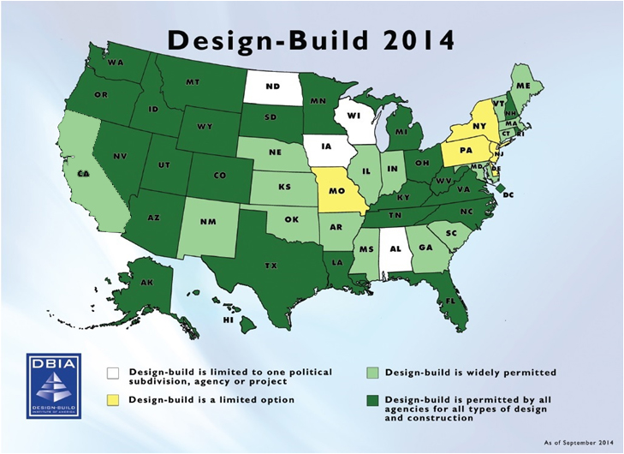
LEGISLATIVE ADVOCACY
State/Local
Notes:
And today.

Slide 11
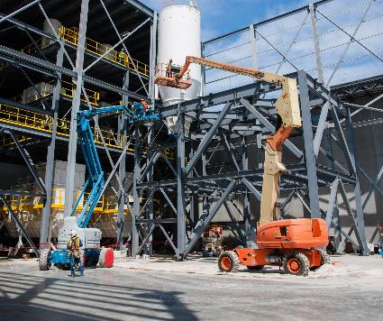
Design-Build is a Mindset
Defined by attitude of everyone involved in project
Success requires team to think and act as a single entity
Master-Builder was not a contractor, an architect or an engineer, but the embodiment of all three
Process is intended to be highly collaborative and fully integrated
Built on trust, mutual respect, teamwork, innovation and creative problem solving
Power of the team will deliver projects faster, better and for optimum cost
Notes:
OK, so that was a little bit of an overview. Let’s dive into the mindset shift necessary and building a trusting relationship.
It is Perhaps the biggest challenge in transitioning to a best value model!
Can we “Trust” each other?
Can we “think” and “act” as one entity?
To that end……next slide

Slide 12
PROCUREMENT
IMPLEMENTING TECHNIQUE NO. 1(D)
Owners should involve senior leadership that is committed to the success of the design-build process, as this will foster a healthy and trusting relationship among the entire project team.
Notes:
To that end. Regarding the previous slide.
You have to have buy in from the top.
That is probably many of you in this webinar. So, I am sort of issuing you all a challenge.
If they are not, put them in contact with me.

Slide 13
MAKING THE MENTAL SHIFT
Notes:
You’ve got to build trust in your teams.
Remember, and I will go a little deeper in this later, but some just won’t get it.
Strengths. Know your strengths.
The Lassen Miracle with Tom Ready.
You will build trust in your teams when you are placing the right strengths onto a team.

Slide 14
Design-Build is a Mindset
Defined by attitude of everyone involved in project
Success requires team to make the mental shift to think and act as a single entity
Master Builder was not a contractor, an architect or an engineer, but the embodiment of all three
165
Notes:
Remember the Master Builder concept from the timeline on an earlier slide?
Most of us are victims of life’s previous experiences … good & bad. The Traditional linear Design-BID-Build method frequently resulted in a very adversarial relationship amongst the parties – transitioning to a “Collaborative” Design-Build relationship requires an active on-going effort to sustain the positive frame of mind. This builds trust.
I was just taking yesterday to some industry folks about how my early design-bid-build experience soured me in the industry. And now I am here trying to advocate that there is a better way to deliver projects as a team.

Slide 15
Collaborative Design-Build mindset
Process is intended to be highly collaborative, fully integrated process
Built on trust, mutual respect, teamwork, innovation and creative problem solving
Power of the team will deliver projects faster, better and for optimum price
Consider co-location during critical portions of project
Notes:
You can use “collaborative” and “progressive” interchangeably. I think it is confusing. So I prefer to just think simply in terms of “Best value”.
You will need Participatory leadership … engaging the entire Team. None of us individually is as smart as ALL of us.
-Eric talked about the “Scramble” version of Golf.
So, what do we as owners bring to the table?
-Builders need to trust that we, as owners, will be fair and consistent.
-Advertise realistic budgets and schedules
-Have the decision makers available.

Slide 16
Get the right people on the bus!
This Photo by Unknown Author is licensed under CC BY-NC-ND
Notes:
I don’t know that there is a magical formula.
As I mentioned, not everyone will get it. Knowing peoples strengths is a start.
I can sniff out change order artist pretty quickly. (Bella Vista example)
Just like the builder can likely sniff out an owner that is disingenuous and doesn’t’ really have the needed trust.
Look, when you enter into a best value, qualifications based selection, you are going to need to trust the process. And Trust that the team you selected is going to give you the best possible project with the fee and GC’s they promised.
When you start to think along the lines of, they are making to much, hiding money in their units, padding their fee, or whatever; do the industry a favor, get off the bus. This delivery model is not for you.
I heard a Superintendent say to a builder once, I saw your vehicle, I am paying you too much money. Get him/her off the bus.
When you look at their vehicles (the builder) and say, wow! Guess what, they earned it. They are taking on an enormous amount of risk for you. They get to drive nice cars.

Slide 17
Time to Face The Facts
Operating and performing effectively in an integrated team is NOT automatic…
and not for everyone
Not every architect, contractor, engineer, or Owner has what it takes
Effective design-build team members posses unique talents
“Just because you can read music doesn’t mean you can play jazz.”
Notes:
Proactive leadership … a concerted effort to go the extra mile for the benefit of the Project.
Trust starts with your commitment to having the right “mindset” on the team.
Hey, I just noticed that lady is flipping off the camera. Get her off the bus.

Slide 18
“Get the right people on the bus, [and] Get the wrong people off the bus!”
~ Jim Collins, Good to Great
Notes:
… and get the right people in the right seats.
Good to Great: Why Some Companies Make the Leap... and Others Don't is a management book by Jim C. Collins that describes how companies transition from being good companies to great companies, and how most companies fail to make the transition.

Slide 19
Undesirable traits For Team members
Judgmental and criticizes
Reactive and automatic
Knows it already
Either/Or thinking
Inflexible and Rigid
Own point of view only
Intolerant of others
Fears differences
Defends assumptions
Protective and/or defensive
Notes:
Recognize any of these characteristics from any previous Projects that didn’t perform as well as expected?
Get them off the bus.
They will erode trust.

Slide 20
Desirable traits For Team members
Accepting of critiques
Responsive and reflective
Values not knowing
Both/And thinking
Flexible and adaptive
Embraces multiple perspectives
Accepting of others
Values differences
Questions assumptions
Curious
Notes:
As opposed to the “Knower” traits on the previous slides … here’s a few of the “Learner” characteristics much more amenable for integrated Design-Build Projects.
Get these folks on the bus.
They will build trust.

Slide 21
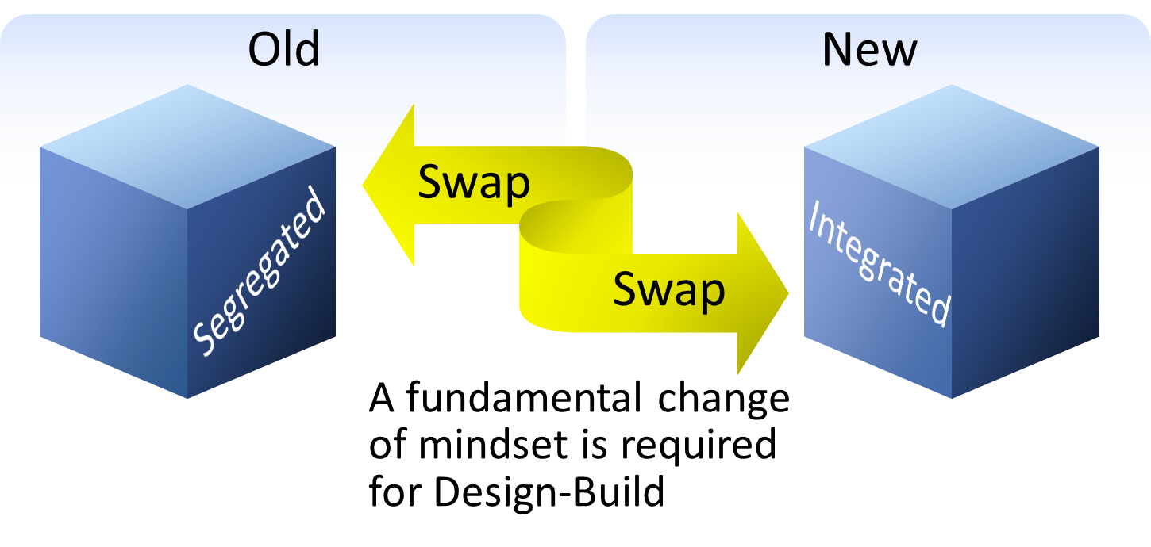
Think Like a Design-Builder
Notes:
Not just sharing information in a “Collaborative” manner, sometimes I think that word is overused without REALLY considering its definition … we should be truly “Integrating” all the Key Players.
Think of football. Go Niners!
We are not lining up on the opposite side of the all any longer.
What is on the opposite side of the ball now are the problems that are faced. OSHPD, DSA

Slide 22
Integrated Design-Build Teams
Fully engaged from Day 1
Listen for what serves the project
Facilitative leadership
Engage in healthy debate/conflict that leads to commitment
Operate in an environment of TRUST
Exemplary communication with full disclosure and transparency
Possess interdisciplinary fluency
Focus on solving the problem rather than protecting your position
Notes:
These things build trust.
Transparency is a key factor in obtaining “Trust”.
Interdisciplinary fluency – recognizing that activities that affect one discipline (Trade) will likely affect others.

Slide 23
Why do Teams Fail?
Notes:
Let me again challenge you, especially you owners on the line:
The Number 1 reason for Team failure is a lack of Trust. Trust changes EVERYTHING! … for better or worse!

Slide 24
KEY FACTORS ENABLING TEAM ALIGNMENT
Early Involvement
Qualifications-Based Selection
Cost Transparency
Fostering an Environment of Trust
Notes:
There are several key factors in gaining team alignment toward the goals. Stolen from DBIA. Look at number 4.
Early Involvement … of all primary key players – the key stakeholders on the Owners side – and not just the A/E & the GC for the Design-Builder but moreover the key trade partners also included early in the process.
Qualifications must be a critical component of source selection process (whether Progressive D-B or Best Value).
-Think about that football example again. Its like choosing the score first, then picking your team to make sure you get to that point. And, if you don’t get that exact score, its gonna be someone's fault.
Cost Transparency … Can’t hit a home run of you don’t know where the fence is!
Trust – perhaps the most powerful attribute of highly successful Teams.
In “Lean” terms, this is the “Validation” phase.

Slide 25
Designing And Constructing To Budget
“Trust the process here!
Design cost relationship in design-build
Here is your goal. Cost and design alignment.
Details of the design
Cost/Range of Design
$
They are heroes here!
Define design commitment
Price and performance are FIXED. This is critical for all parties to understand the difference between design “evolution” trending versus “changes”
Notes:
The “design-build to budget” curve should esoterically achieve the most value within the budget.
This is how design and cost are related in Design-Build
Performance is fixed at the time of contract award by the Owner’s Project Criteria. Trust it is done right.
Cost is fixed at the time of contract award by the Design-Builder’s price proposal. Trust it is sufficient.
Even When the elements of trust are in place individually, we also need to trust the process.

Slide 26
Thank you!
Feel free to email me questions at: bamitchell@ucdavis.edu

