Slide 1





Maximizing Success on Integrated Projects:
An Owner’s Guide
An Owner’s Only Presentation
September 9, 2016
Greg Gidez, DBIA, AIA
Keith Molenaar, PhD, DBIA

Slide 2

Collaboration
What is COLLABORATION?
col·lab·o·rate
kəˈlabəˌrāt/
verb: collaborate;
work jointly on an activity, especially to produce or create something.

Slide 3

What is Integration?
in·te·grate
ˈin(t)əˌɡrāt/
verb: integrate
combine (one thing) with another so that they become a whole.
bring (people or groups with particular characteristics or needs) into equal participation
Notes:
Simplistically a project can be broken down into two phases, the solution phase (design) and the schedule (or construction assembly) phase. You can’t get to the schedule, if you can’t get to the solution. Designers are trained to solve problems and will continue to noodle on the solution until the fees run out. Your job is to make sure that they have the right info at the right time to make the right design decision and arrive at the solution. The solution phase includes the Owner. An AWOL Owner is not around to make decisions and guide the team. So managing the Owner is as important as managing the designers. You are managing the information to effectively develop the design.

Slide 4
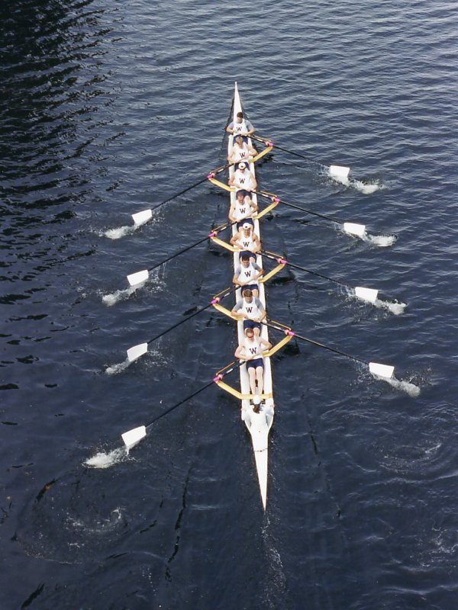
INTEGRATION IS A TEAM SPORT
POETRY IN MOTION
Notes:
Simplistically a project can be broken down into two phases, the solution phase (design) and the schedule (or construction assembly) phase. You can’t get to the schedule, if you can’t get to the solution. Designers are trained to solve problems and will continue to noodle on the solution until the fees run out. Your job is to make sure that they have the right info at the right time to make the right design decision and arrive at the solution. The solution phase includes the Owner. An AWOL Owner is not around to make decisions and guide the team. So managing the Owner is as important as managing the designers. You are managing the information to effectively develop the design.

Slide 5

co·he·sion
kōˈhēZHən/
noun: cohesion
the action or fact of forming a united whole.

Slide 6

What is an integrated project?
Notes:
Simplistically a project can be broken down into two phases, the solution phase (design) and the schedule (or construction assembly) phase. You can’t get to the schedule, if you can’t get to the solution. Designers are trained to solve problems and will continue to noodle on the solution until the fees run out. Your job is to make sure that they have the right info at the right time to make the right design decision and arrive at the solution. The solution phase includes the Owner. An AWOL Owner is not around to make decisions and guide the team. So managing the Owner is as important as managing the designers. You are managing the information to effectively develop the design.

Slide 7

What is Project success?
Notes:
Simplistically a project can be broken down into two phases, the solution phase (design) and the schedule (or construction assembly) phase. You can’t get to the schedule, if you can’t get to the solution. Designers are trained to solve problems and will continue to noodle on the solution until the fees run out. Your job is to make sure that they have the right info at the right time to make the right design decision and arrive at the solution. The solution phase includes the Owner. An AWOL Owner is not around to make decisions and guide the team. So managing the Owner is as important as managing the designers. You are managing the information to effectively develop the design.

Slide 8

For the Owner?
For the Architect?
For the Engineer?
For the Builder?
For the Trade?
For the user?
Notes:
Simplistically a project can be broken down into two phases, the solution phase (design) and the schedule (or construction assembly) phase. You can’t get to the schedule, if you can’t get to the solution. Designers are trained to solve problems and will continue to noodle on the solution until the fees run out. Your job is to make sure that they have the right info at the right time to make the right design decision and arrive at the solution. The solution phase includes the Owner. An AWOL Owner is not around to make decisions and guide the team. So managing the Owner is as important as managing the designers. You are managing the information to effectively develop the design.

Slide 9

WHAT IS THE RESEARCH?
Notes:
Greg
Key Point
This theory is not just HP, but it has been proved through research in the industry.

Slide 10
Project Delivery Research
In 1997-1998 the Construction Industry Institute in collaboration with Penn State University published seminal research indicating Design Build out performed CM at Risk or Design Bid Build in terms of
  Lower cost,
  Improved schedule
  Better quality
Metric | DB vs. DBB | CM@R vs. DBB | DB vs. CM@R
Unit Cost | 6.1% lower | 1.6% lower | 4.5% lower
Construction Speed | 12% faster | 5.8% faster | 7% faster
Delivery Speed | 33.5% faster | 13.3% faster | 23.5% faster
Cost Growth | 5.2% less | 7.8% more | 12.6% less
Schedule Growth | 11.4% less | 9.2% less | 2.2% less
The more integrated, the better the performance
Singular vs multiple contracts
1998 CII RT 133 Research

Slide 11
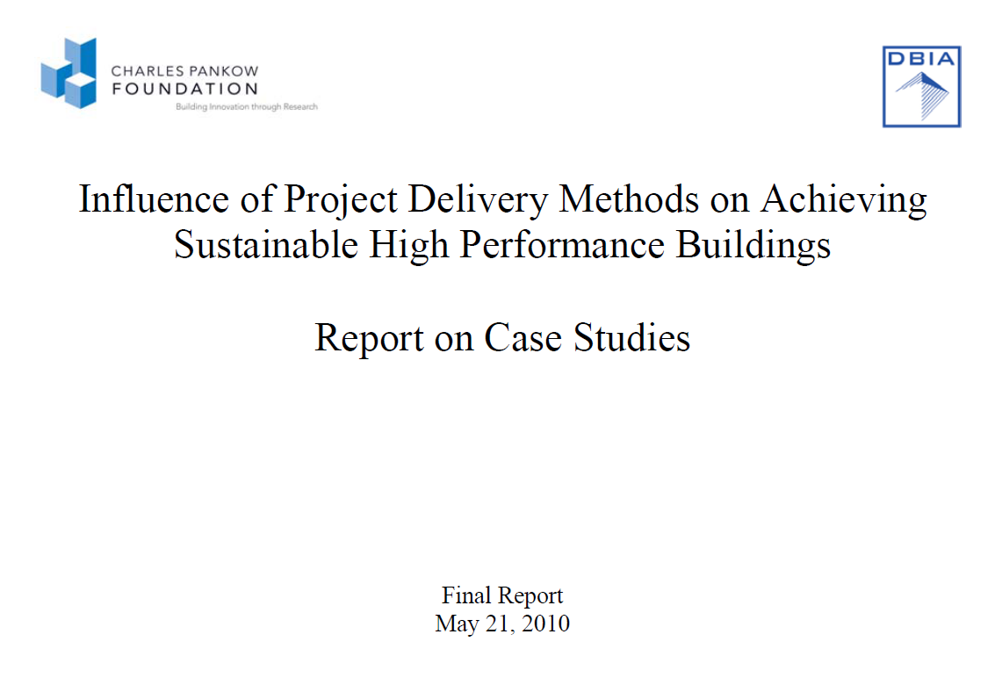



Team Integration and Sustainability
  When sustainability is a goal –
  The higher the level of team integration the higher the performance of the building
  The greater the Owner involvement, the better the opportunity to achieve sustainable goals
https://www.dbia.org/resource-center/Documents/
CPF_ThrustII_05212010_Final.pdf

Slide 12

Impacts of the Previous Research
Many State and Federal agencies changed procurement laws to permit alternate forms of project delivery
Owner’s turned to Design Build and CMR to increase potential for project success
Demand for sustainability has driven demand for integrated approaches

Slide 13
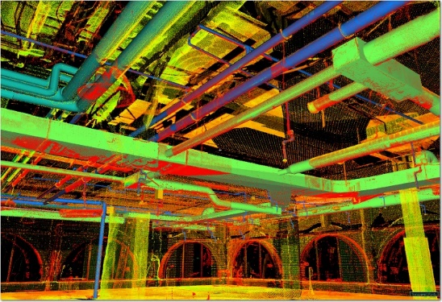
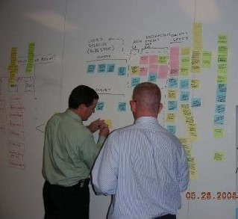

What has Changed?
Is the previous research still relevant?
What has changed?
  Technology
  Building Information Modeling
  IPD, Progressive DB, P3
  Construction technologies
  Economy
  Level of sophistication
What are the factors that improve outcomes in any project delivery strategy?

Slide 14

How can an Owner best structure the project for a successful outcome?

Slide 15
Maximizing Success in Integrated Projects: An Owner’s Guide
• Greg Gidez (co-chair), Hensel Phelps Construction Co.
• Mark Konchar (co-chair), Balfour Beatty Construction
• Howard W. Ashcraft, Esq., Hanson Bridgett LLP
• Spencer Brott, Trammell Crow Real Estate Services, Inc.
• Bill Dean, M.C. Dean, Inc.
• Tom Dyze, Walbridge
• Matthew Ellis, US Army Corps of Engineers
• Behzad Esmaeili, University of Nebraska-Lincoln
• Bryan Franz, University of Florida
Diana Hoag, Xcelsi Group, LLC
• Mike Kenig, Holder Construction
• Robert Leicht, Penn State University
• Russell Manning, Department of Defense
• John Messner, Penn State University
• John Miller, Barchan Foundation, Inc.
• Keith Molenaar, Univ. of Colorado
• Brendan Robinson, U.S. Architect of the Capitol
• Victor Sanvido, Southland Industries
• Ronald Smith, Kaiser Permanente
• David P. Thorman, Former California State Architect

Slide 16
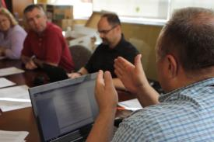
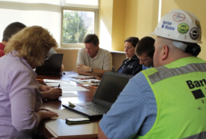
Team
Integration
Integration
Degree to which team members from separate organizations and disciplines are engaged in collaborative activities
Group Cohesion
Participation in:
    Joint Goal Setting
    Cross Disciplinary design charrettes
    BIM Execution Planning
Increased sharing of information and analysis through BIM
Increased team interaction through colocation
  Higher levels of integration led to:
Reduced schedule growth
Enabled more intense schedules
Led to more cohesive teams

Slide 17
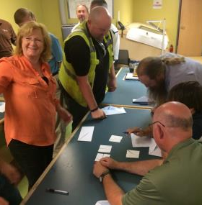
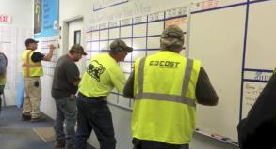
Team
Group Cohesion
Integration
Degree to which team, as individuals, have shared, task commitment, group pride, and interpersonal alignment
Group Cohesion
Commitment to shared goals
High levels of team chemistry
Communication is timely and effective
  Higher group cohesiveness led to:
Reduced cost growth
Higher system quality
Improved turnover experience

Slide 18
Factor Value
Group Cohesion
Team Integration
Team Integration

Slide 19
Factor Value
70%
of projects delivered late had below average levels of Team Integration
Group Cohesion
Team Integration

Slide 20
Factor Value
Group Cohesion
60%
of on budget projects had above average levels of Group Cohesion
Team Integration

Slide 21
Delivery Method
Group Cohesion
DBB
Team Integration

Slide 22
Delivery Method
CM@R
Group Cohesion
Team Integration

Slide 23
Delivery Method
Group Cohesion
DB
Team Integration

Slide 24
Delivery Method
IPD
Group Cohesion
Team Integration

Slide 25
Delivery Method
IPD
CM@R
Group Cohesion
We need to consider more than just delivery method
DB
Large variance within each delivery method
DBB
Team Integration

Slide 26
How did we come to these findings?

Slide 27
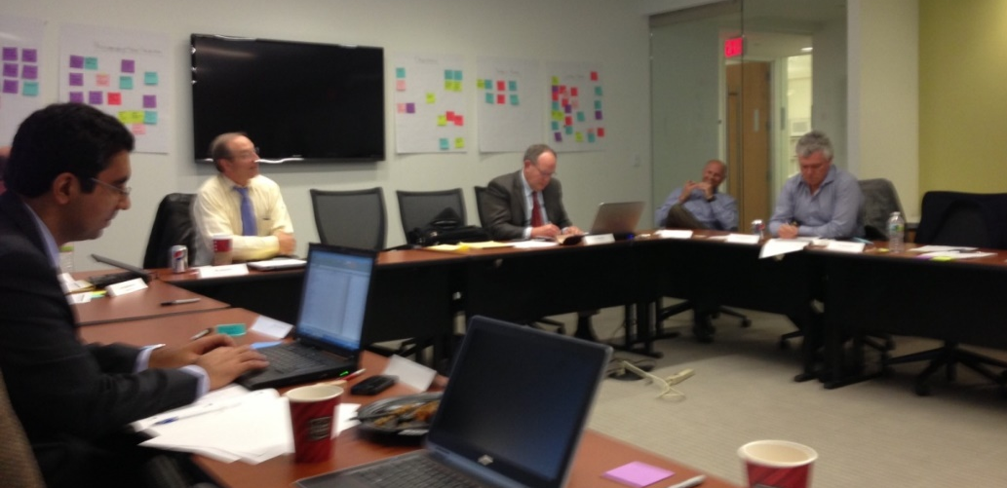
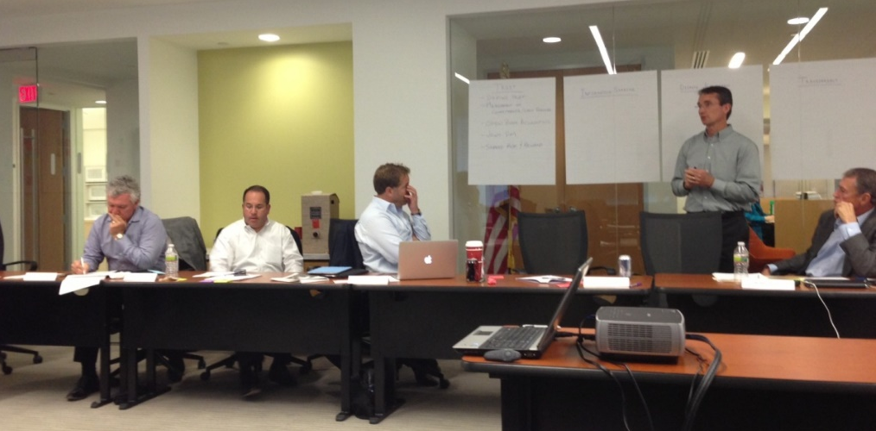
Study Background
Research Charrette
A structured 2-day workshop that combined surveys and focus group discussion
Attendees: CM/GCs, specialty contractors, owners, lawyers, architects

Slide 28
Study Background
The Role of Team Integration in Project Performance
Methodology: Empirical Study
Large-sample data collection
Latent variable analysis
Structural modeling of relationships
Sponsors:
Charles Pankow Foundation
Construction Industry Institute (CII)

Slide 29
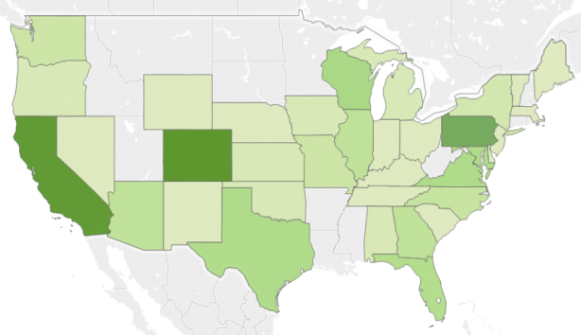
Data Set
204 Projects
Public: 127 (62%)
Private: 77 (38%)
Number of Projects
Completed: 2008 - 2013
1
32
Facility Types
Facility Sizes
Educational
56 (27%)
(4%) 8
> 700,000 ft²
Office
41 (20%)
(3%) 7
600,000 - 699,000 ft²
Health Care
32 (16%)
(2%) 3
500,000 - 599,000 ft²
Lodging
27 (13%)
(3%) 6
400,000 - 499,000 ft²
Commercial
20 (10%)
(7%) 15
300,000 - 399,000 ft²
Sports & Recreation
11 (5%)
(13%) 26
200,000 - 299,000 ft²
Manufacturing
11 (5%)
(24%) 49
100,000 - 199,000 ft²
Correctional
4 (2%)
(44%) 90
0 - 99,000 ft²
Transportation
2 (1%)

Slide 30
The Factors
Group Cohesion
Development into an
effective unit
Delivery Strategy
Plan for structuring design
and construction services
Project Performance
Cost
Schedule
Quality
Team Integration
Bringing together In
high-quality interactions

Slide 31
Measurements of participation in high-quality interactions, suspected to be driven by the level of team integration:
The Factors
Number of BIM uses from a predefined list
Proportion of core* project team participating in:
*Includes owner, designer, primary contractor, MEP trades and structural trades
BIM planning
Goal setting
Design charrettes
Co-location
Percentage of offsite prefabrication
.72
.61
.43
.57
.50
Team Integration
Bringing together In
high-quality interactions
Number of BIM Uses
BIM Planning Participation
Goal Setting Participation
Charrette Participation
Co-location Participation
Offsite Prefabrication
R²=.51
R²=.34
R²=.32
R²=.25
R²=.18

Slide 32
The Factors
Group Cohesion
Development into an
effective unit
Delivery Strategy
Plan for structuring design
and construction services
Project Performance
Cost
Schedule
Quality
Team Integration
Bringing together In
high-quality interactions

Slide 33
The Factors
R²=.64
R²=.58
R²=.68
Frequency of Compromise
Team
Chemistry
Timeliness of Communication
Goal
Commitment
Formality of Communication
Group Cohesion
Development into an
effective unit
.76
.80
.83
Measures of the team environment, thought to be reflective of the level of group cohesion:
Frequency of compromise
Team chemistry
Poor
Excellent
Timeliness of communication
Never on time
Always on time
Commitment to project goals
Weakly
Strongly
Formality of communication

Slide 34
The Factors
Group Cohesion
Development into an
effective unit
Delivery Strategy
Plan for structuring design
and construction services
Project Performance
Cost
Schedule
Quality
Team Integration
Bringing together In
high-quality interactions

Slide 35
Single contract for design and construction
The Factors
Delivery Method
Builder was hired at
SD or earlier
Trades were hired at
SD or earlier
Class I
Class II
Class III
Class IV
Class V
Payment Terms
Delivery Strategy
Plan for structuring design
and construction services
Builder had an open
book contract
Builder was
prequalified
Procurement Process
Trades were
prequalified
Measurements of the project organization that reflect the owner’s delivery strategy
Builder was selected
based on cost of work
Trades were selected
based on cost of work

Slide 36
Timing of Involvement
Class I (n=19)
Percentage of Projects
Project Delivery Strategy
Early Involvement of the Builder and/or Trades
Class I
Class III (n=54)
Class II
Class III
Class IV
Class V (n=36)
Class V
Primary Contractor / CM
Trade Contractors
PRE = Pre-Design
CONC = Conceptual Design
SD = Schematic Design
DD = Design Development
CD = Construction Documents
BID = Bidding
Phase of Design

Slide 37
Underlying Themes
Project Delivery Strategy
Early Involvement of the Builder and Trades
Open Book
Payment Terms
Class I
Class II
Class III
Class IV
Class V
Qualification Based Selection

Slide 38
Delivery Strategy
V
III
Group Cohesion
II
IV
I
Team Integration

Slide 39
The Owner’s Guide
Pulling it all together
Reduced cost growth
Improved turnover experience
Higher system quality
Reduced schedule growth
Enabled more intense schedules
Led to more group cohesion

Slide 40
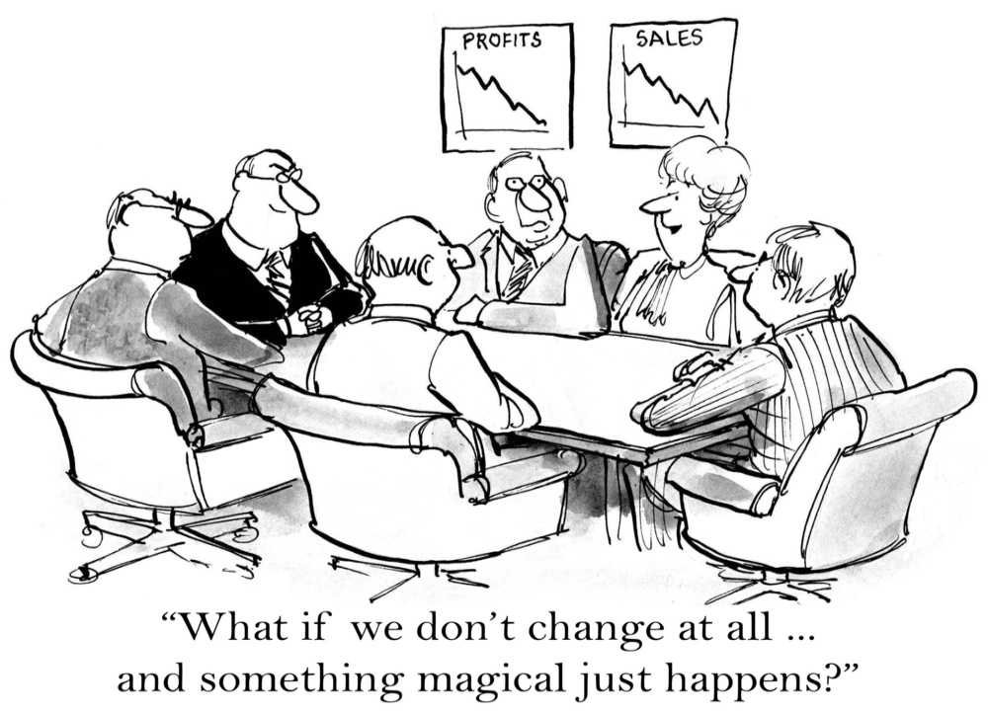
How do I use this information for my projects?

Slide 42
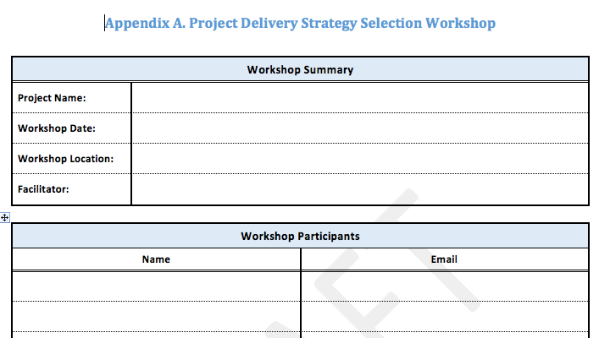
Workshop
Workshop Goal
Identify the targeted delivery
strategy for your project
Bring together key stakeholders BEFORE setting the strategy
Preparation:
Outline of project scope and goals
Define / invite key stakeholders
Approximate timeline / budget

Slide 43

The Process
1. Define Project Needs
Assess goals for management and performance
2. Explore Delivery Options
Discuss delivery decisions with attention to integrated processes and team cohesion
3. Select Delivery Strategy
Identify an optimal delivery strategy consistent with owner constraints
1a.
Document project summary information (e.g. size, type, etc.)
2a-b.
Discuss organizational structure (single vs. split D&C contracts, timing of core team involvement)
1b.
Determine project goals (e.g. time, cost, quality, etc.)
3a.
Identify owner’s legal and policy constraints (e.g. procurement law, staff experience, etc.)
2c.
Discuss contract payment terms for builder and key trades (open vs. closed book)
3b.
Determine strategy by comparing to research results (e.g. Classes I-V)
2d-g.
Discuss team assembly (e.g. selection process and criteria, prior experience, etc.)
3c.
Select and Implement Project Delivery Strategy
Owner’s Project Delivery Strategy
– Project summary
– Project goals
– Etc.

Slide 44
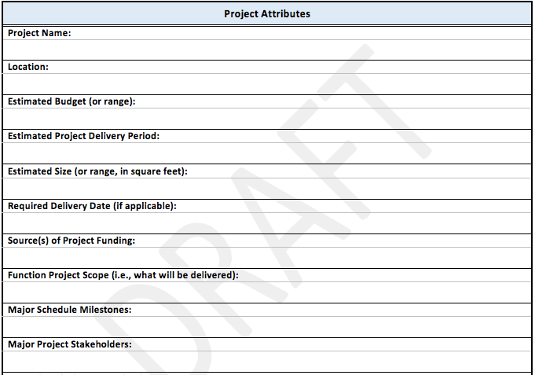
Step 1a
Define Project Needs
Formally document the project purpose and scope
Document project summary information
a.
b.
Determine project goals

Slide 45
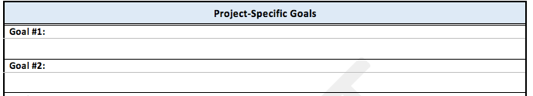
Step 1b
Define Project Goals
Define the specific goals for the project and functionality of the completed facility.
Document project summary information
a.
Schedule
Accelerate start of project revenue
Cost
Maximize value for project budget
Complete the project on budget
Functional
Minimize inconvenience to current facility users
b.
Determine project goals

Slide 46
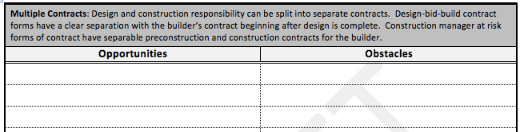
Step 2a-b
Explore Delivery Options
Discuss the organizational structure
a-b.
Org.
Structure
Design Responsibility
  Shared contract or split
Early Involvement
  Builder
  Specialty Trades
Timing of Involvement
Pre-Schematic Design
Late Design
Post-Design
c.
Payment Terms
Team Assembly Process
d-g.

Slide 47
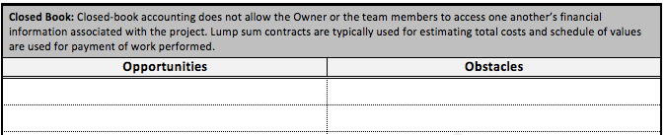
Step 2c
Builder Payment Terms
Discuss the contract payment terms
a-b.
Org.
Structure
Open Book
Cost-reimbursable
Guaranteed Max Price or Cost Plus
Closed Book
Schedule of Values
  Lump Sum Price
Specialty Contractor Payment Terms
c.
Payment Terms
Team Assembly Process
d-g.

Slide 48
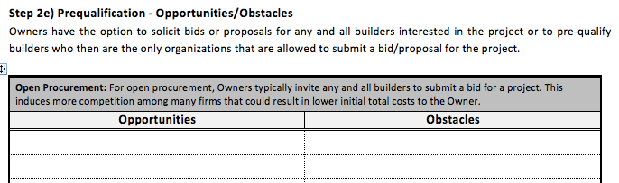
Step 2d-g
Explore Team Assembly
Discuss the team assembly process
a-b.
Org.
Structure
Selection Criteria
Bid price
Best Value
Qualification Based Selection
Prequalification
Prequalify
Open Procurement
Specialty Trade Procurement
Selection Criteria
Prequalification
c.
Payment Terms
Team Assembly Process
d-g.

Slide 49
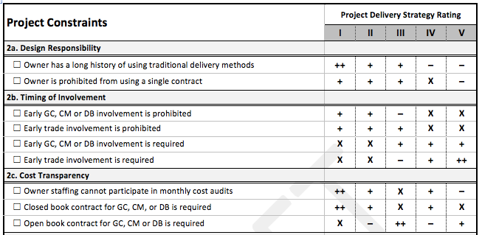

Step 3a
Identify Constraints
Discuss legal or policy constraints
a.
Identify Constraints
Compare delivery decisions
b.
c.
Reflect on consistency of strategy

Slide 50
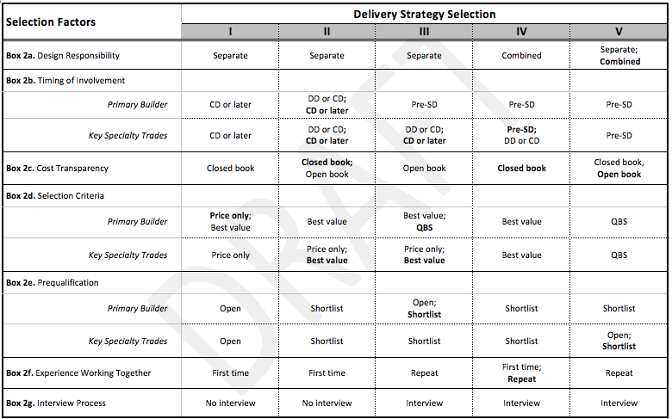
Step 3b
Compare by Strategy
Apply underlying themes to inform strategy decisions
a.
Identify Constraints
Compare delivery decisions
b.
c.
Reflect on consistency of strategy

Slide 51
Step 3c
Reflect on Consistency
Regardless of the selected strategy, consider implementing these critical success factors:
a.
Identify Constraints
Integrated Processes
Number of BIM uses from a predefined list
Proportion of core* project team participating:
BIM planning
Compare delivery decisions
Goal setting
b.
Design charrettes
Co-location
Behaviors leading to Team Cohesion
Team chemistry
c.
Reflect on consistency of strategy
Timeliness of communication
Commitment to project goals

Slide 52
http://bim.psu.edu/delivery

Slide 53

How can you help inform the process?

Slide 54

GET SMART
1st THING
Notes:
Simplistically a project can be broken down into two phases, the solution phase (design) and the schedule (or construction assembly) phase. You can’t get to the schedule, if you can’t get to the solution. Designers are trained to solve problems and will continue to noodle on the solution until the fees run out. Your job is to make sure that they have the right info at the right time to make the right design decision and arrive at the solution. The solution phase includes the Owner. An AWOL Owner is not around to make decisions and guide the team. So managing the Owner is as important as managing the designers. You are managing the information to effectively develop the design.

Slide 55

MAKE THE MENTAL SHIFT
Notes:
Simplistically a project can be broken down into two phases, the solution phase (design) and the schedule (or construction assembly) phase. You can’t get to the schedule, if you can’t get to the solution. Designers are trained to solve problems and will continue to noodle on the solution until the fees run out. Your job is to make sure that they have the right info at the right time to make the right design decision and arrive at the solution. The solution phase includes the Owner. An AWOL Owner is not around to make decisions and guide the team. So managing the Owner is as important as managing the designers. You are managing the information to effectively develop the design.

Slide 56

RIGHT PERSON IN THE RIGHT SEAT ON THE BUS
Notes:
Simplistically a project can be broken down into two phases, the solution phase (design) and the schedule (or construction assembly) phase. You can’t get to the schedule, if you can’t get to the solution. Designers are trained to solve problems and will continue to noodle on the solution until the fees run out. Your job is to make sure that they have the right info at the right time to make the right design decision and arrive at the solution. The solution phase includes the Owner. An AWOL Owner is not around to make decisions and guide the team. So managing the Owner is as important as managing the designers. You are managing the information to effectively develop the design.

Slide 57
INTEGRATION IS A TEAM SPORT
POETRY IN MOTION
Notes:
Simplistically a project can be broken down into two phases, the solution phase (design) and the schedule (or construction assembly) phase. You can’t get to the schedule, if you can’t get to the solution. Designers are trained to solve problems and will continue to noodle on the solution until the fees run out. Your job is to make sure that they have the right info at the right time to make the right design decision and arrive at the solution. The solution phase includes the Owner. An AWOL Owner is not around to make decisions and guide the team. So managing the Owner is as important as managing the designers. You are managing the information to effectively develop the design.

Slide 58

Procurement
Contracts
Execution
Notes:
Greg
Design Phase Management is a soup to nuts proposition. It begins before the project is awarded and is managed throughout. Consider a project where HP Services might be involved. Knowing how the building will be operated influences the design, and that should be discussed at the design commencement.
So effective design management starts in the procurement phase and continues throughout the life cycle of the project. Knowing when we are contractually obligated to support the design phase is important, as well as knowing the risk profiles of different delivery strategies will inform on how best to manage the work
58

Slide 59


OWNERS

Slide 60
Impacts of this Research
Federal Owners and State agencies are strategically determining best project delivery strategies to maximize success
Maximizing success requires a holistic strategy, an integrated team and a motivated group of individuals

Slide 61

What you should remember?
Best path to project success is through building a TEAM – integration / cohesion
Teams are influenced through project delivery decisions – early involvement, open book, qualifications driven
Project Delivery needs to be developed as a strategy across the project

Slide 62
Maximizing Success on Integrated Projects:
An Owner’s Guide
An Owner’s Only Presentation
September 9, 2016
Greg Gidez, DBIA, AIA
Keith Molenaar, PhD, DBIA

