Slide 1
Go to www.waterdesignbuild.com – Free PDF/reduced rate on hard copies for DBIA members.
Moderated by Gordon Childress, Skanska

Slide 2
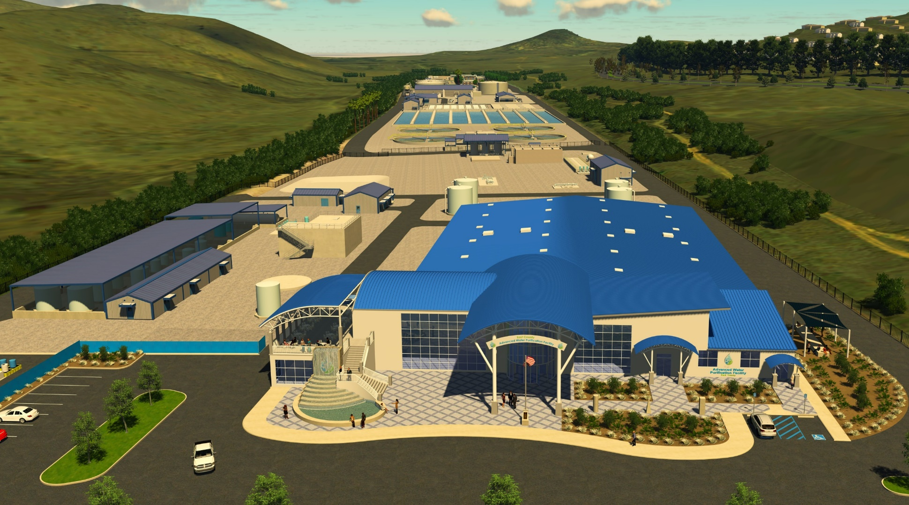
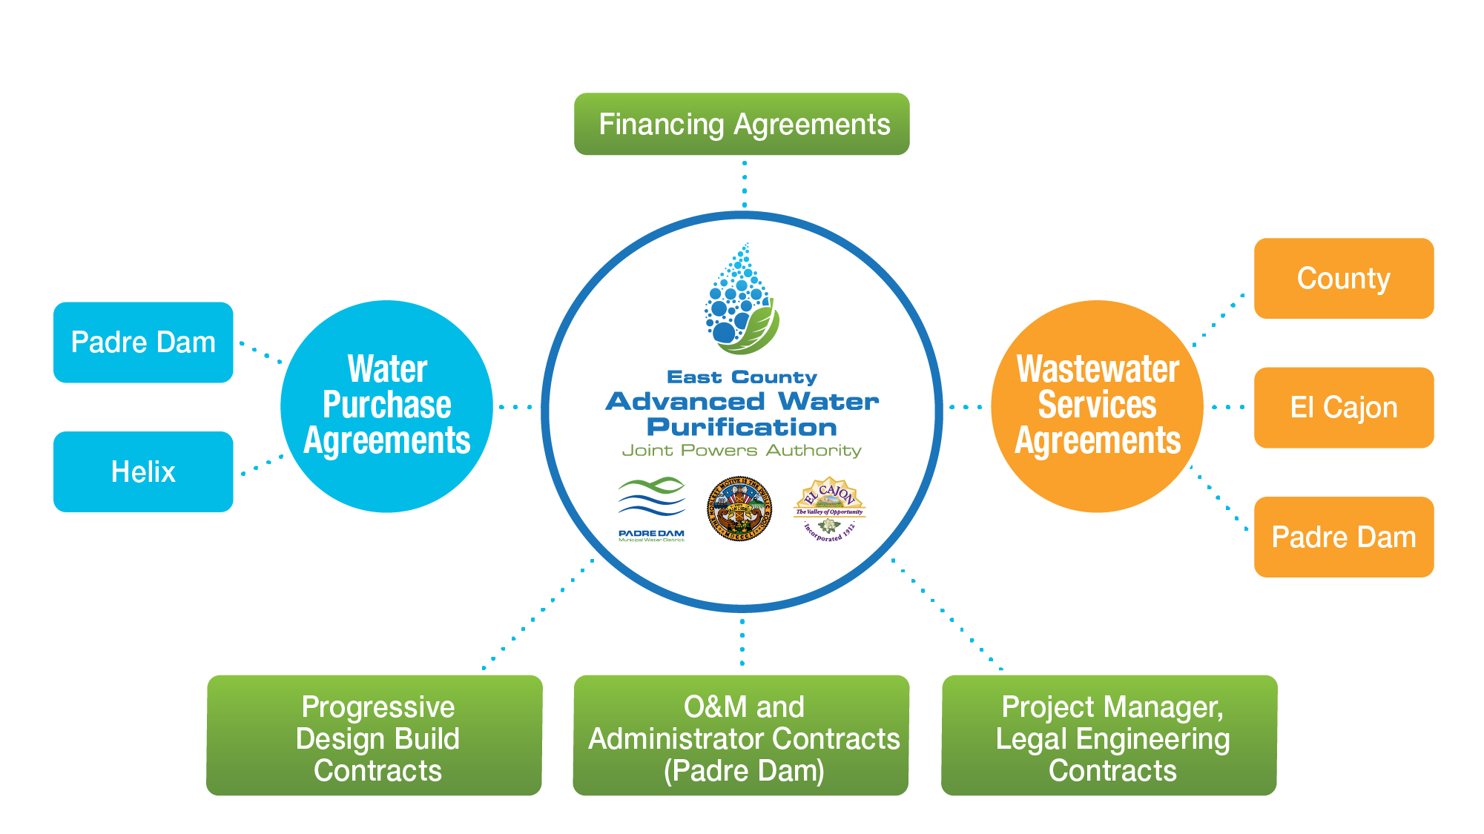
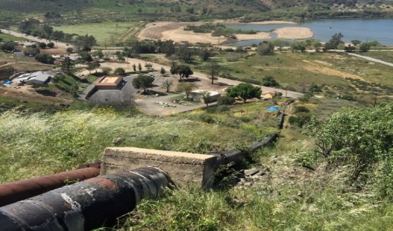
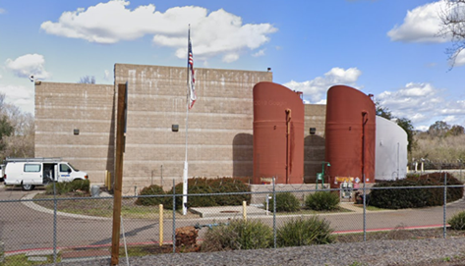
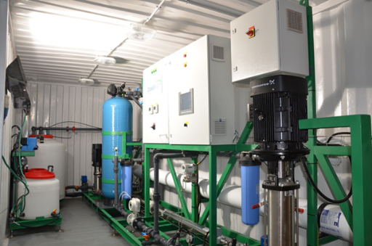
Benefits
Program Governance Structure
Procurement Packages
Package #1 (~300M) Water Recycling Facility, Advanced Water Purification Facility, Solids Handling Facility, Visitors Center
Package #2 (~$40M) Purified Water Pipeline, Dechlorination Facility and Lake Jennings Inlet
Package #3 (~$40M) Influent Pump Stations, Force Mains and Residuals Bypass System
Package #4 (Pending) Regional Brine Line

